Slide 1
<< Settlers >>
of
<< Catron >>
Bao Tran + Luke Lattig

Slide 2
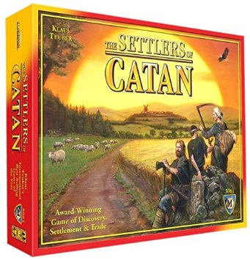
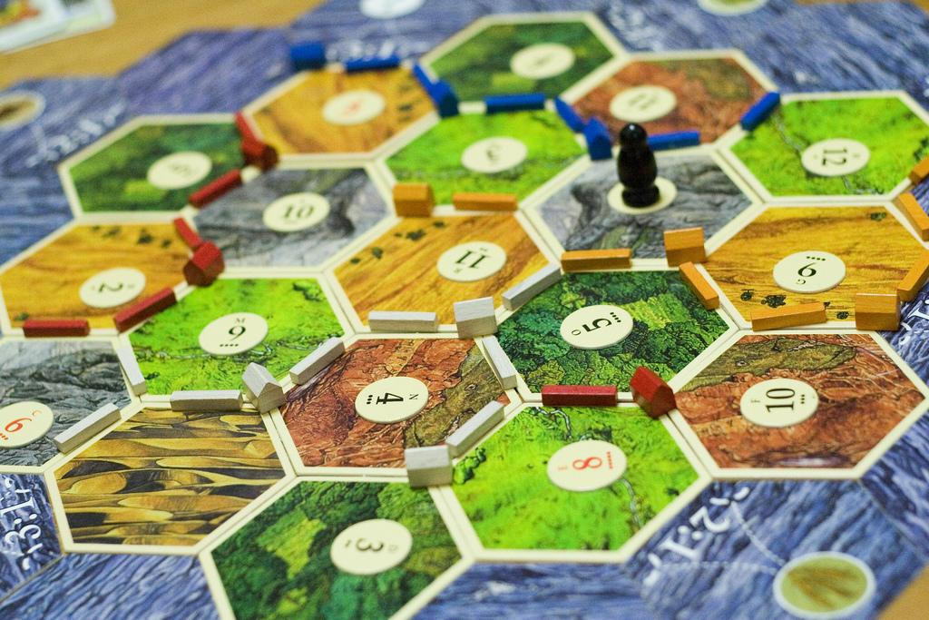
<< Settlers of Catan Explained >>
2+ player board game
19 hexagonal tiles, randomly assigned to places on the board
Tile values cannot be adjacent to each other
Each tile provides resources when its value is rolled based on how the board is designed

Slide 3
<< Project Requirements >>
<< Challenges >>
Randomized Board
Resource Gain
Save Capability
Checks for Valid Town + Road Placement
Creating a Randomizable Board
Checking for Valid Placement

